Slide 1
Gene Expression - Protein Synthesis

Slide 2
What you need to complete
Read Chapter 3 Biology WA ATAR Units 3 & 4
Answer Biology WA ATAR Question Sets
Set 3.3 pg. 63 Q1 – 5
Set 3.4 pg. 65 Q 1 – 4
Set 3.5a pg. 66 Q 1 – 4
Set 3.5b pg. 69 Q 1 – 4
Set 3.5c pg. 73 Q 1 – 4
Set 3.6 pg. 75 Q 1 – 5
NOTE: Some of these question have been used in this PPT and the note taking scaffold. These are to be completed over 2 weeks
Biozone Activities
120
121
122
123
124
126
127
128
129
130
195

Slide 3
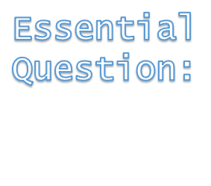
Syllabus:
Proteins, including enzymes and structural proteins, are essential to the cell structure and functioning
Using examples describe how enzymes and structural proteins are essential to cell structure and functioning

Slide 4
Topic Question 1: Give examples of enzymes that are essential to cell functioning
Enzyme | Cell function involved in

Slide 5
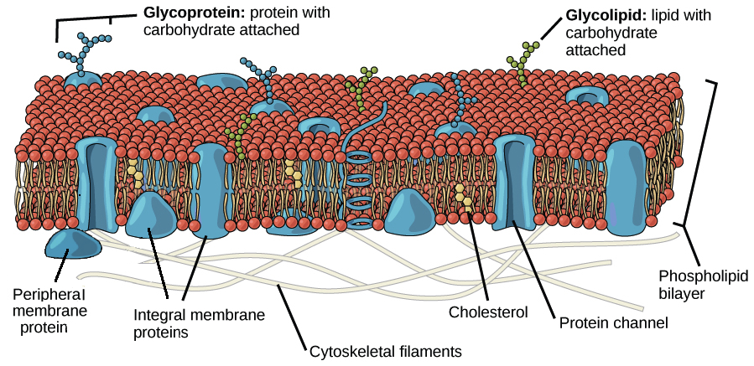
Topic Question 2: Give examples of structural proteins that are essential to cell structure

Slide 6
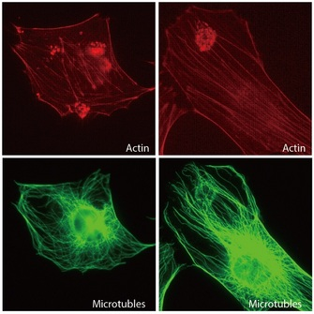
Topic Question 2: Give examples of structural proteins that are essential to cell structure

Slide 7
Syllabus:
The genetic code is a base triplet code; genes include ‘coding’ and ‘non-coding’ DNA, and many genes contain information for protein production
Describe the genetic code of a cell

Slide 8
Topic Question 1: What is gene expression
Gene expression is the process by which the information encoded in a gene is used to direct the assembly of a protein molecule (https://www.genome.gov/genetics-glossary/Gene-Expression)
Protein synthesis is the process of making a protein using the information encoded in a gene so is an essential step in gene expression
Lets see how this is done exactly….

Slide 9
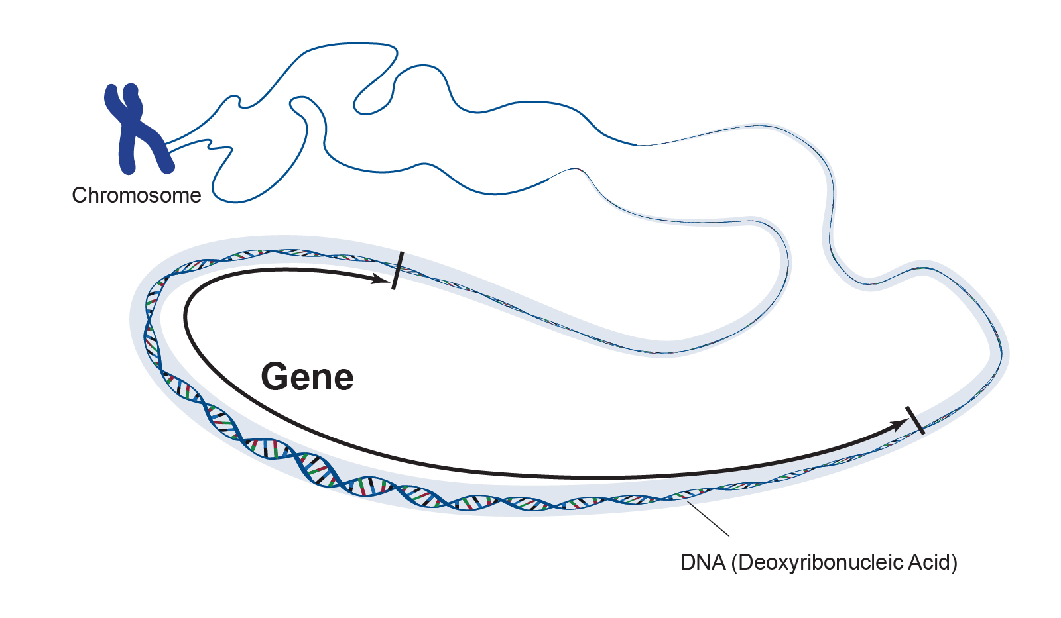
Topic Question 2: Define the term gene
A unit of heredity that transmits information from one generation to the next
A segment of DNA that codes for a polypeptide

Slide 10
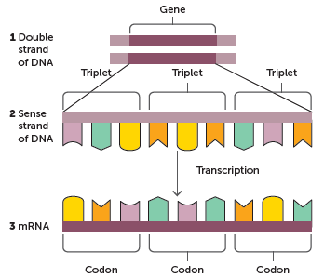
Coding and non-coding DNA
Topic Question 3: What is the genetic code?
The genetic code is the term used for the way that the four nitrogenous bases of DNA are ordered.

Slide 11
Topic Question 4: How is the genetic code read?
In the genetic code, each set of three DNA nucleotides in a row counts as a triplet and codes for an mRNA triplet called a codon.

Slide 12
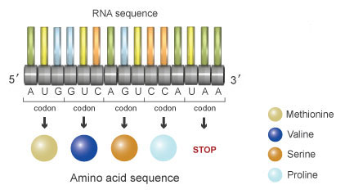
Topic Question 4: How is the genetic code read?
The mRNA codon (three nucleotides) is read by cellular machinery and is translated into a single, specific amino acid.

Slide 13
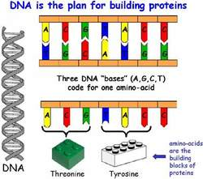
Topic Question 4: How is the genetic code read?

Slide 14
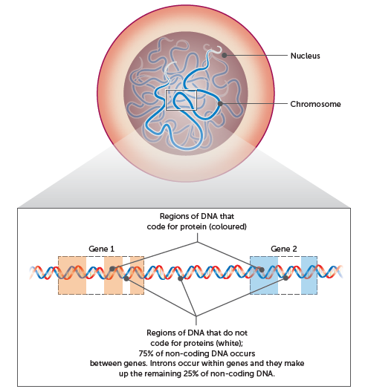
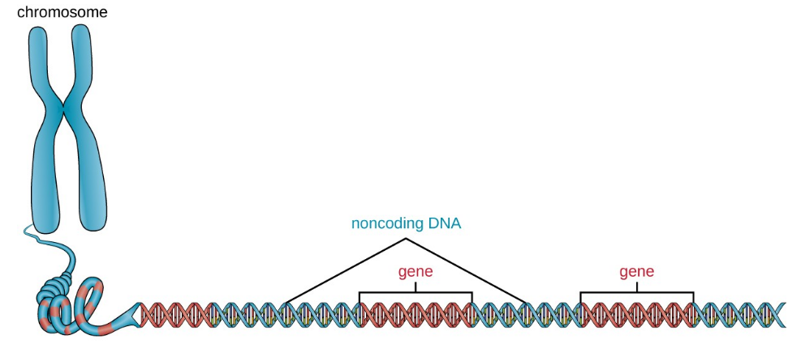
Coding and non-coding DNA
Topic Question 5: Describe the terms coding and non-coding DNA
Coding DNA

Slide 15
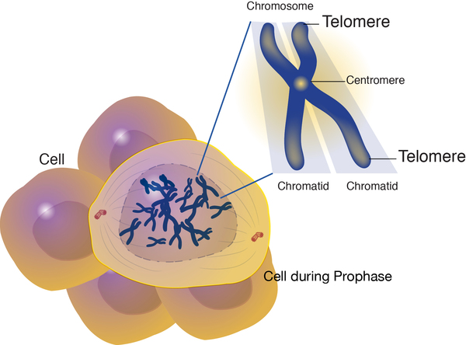
Coding and non-coding DNA
Topic Question 6: Give examples of noncoding DNA
WATCH: https://www.youtube.com/watch?v=M4ut72kfUJM
Stop at 5:12 mins
Intons
Promoters
Enhancers of genes
Segments of DNA used to make functional DNA

Slide 16
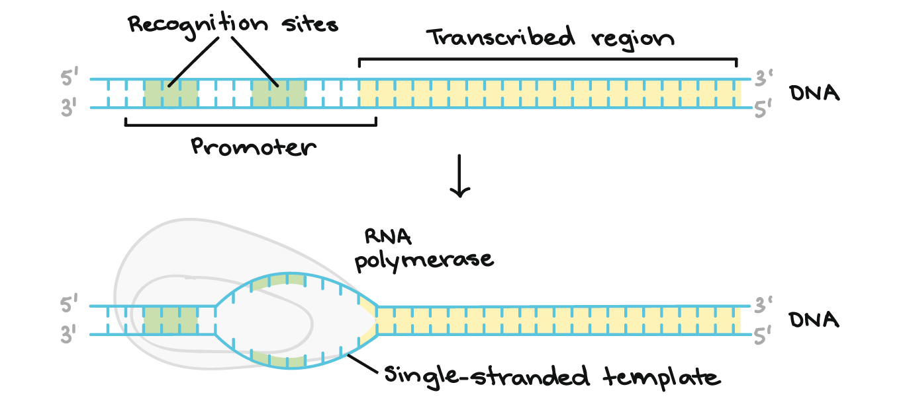
Coding and non-coding DNA
Topic Question 6: Give examples of noncoding DNA
The promoter is the sequence typically referred to that's right next to where a gene is about to be transcribed.
It's the region where certain regulatory elements will bind; these are proteins that will bind to help RNA get transcribed.

Slide 17
Coding and non-coding DNA
Topic Question 7: What is meant by the term functional RNA
WATCH: https://www.youtube.com/watch?v=M4ut72kfUJM
Start at 5:12 mins

Slide 18
Coding and non-coding DNA
Topic Question 8: Define the terms intron and exon
WATCH: https://www.youtube.com/watch?v=M4ut72kfUJM
Start at 5:49 mins

Slide 19
Syllabus:
Protein synthesis involves transcription of a gene into messenger RNA in the nucleus, and translation into an amino acid sequence at the ribosome
Describe the process a cell uses to make a protein

Slide 20
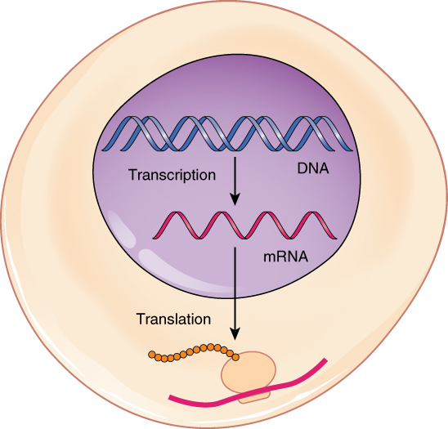
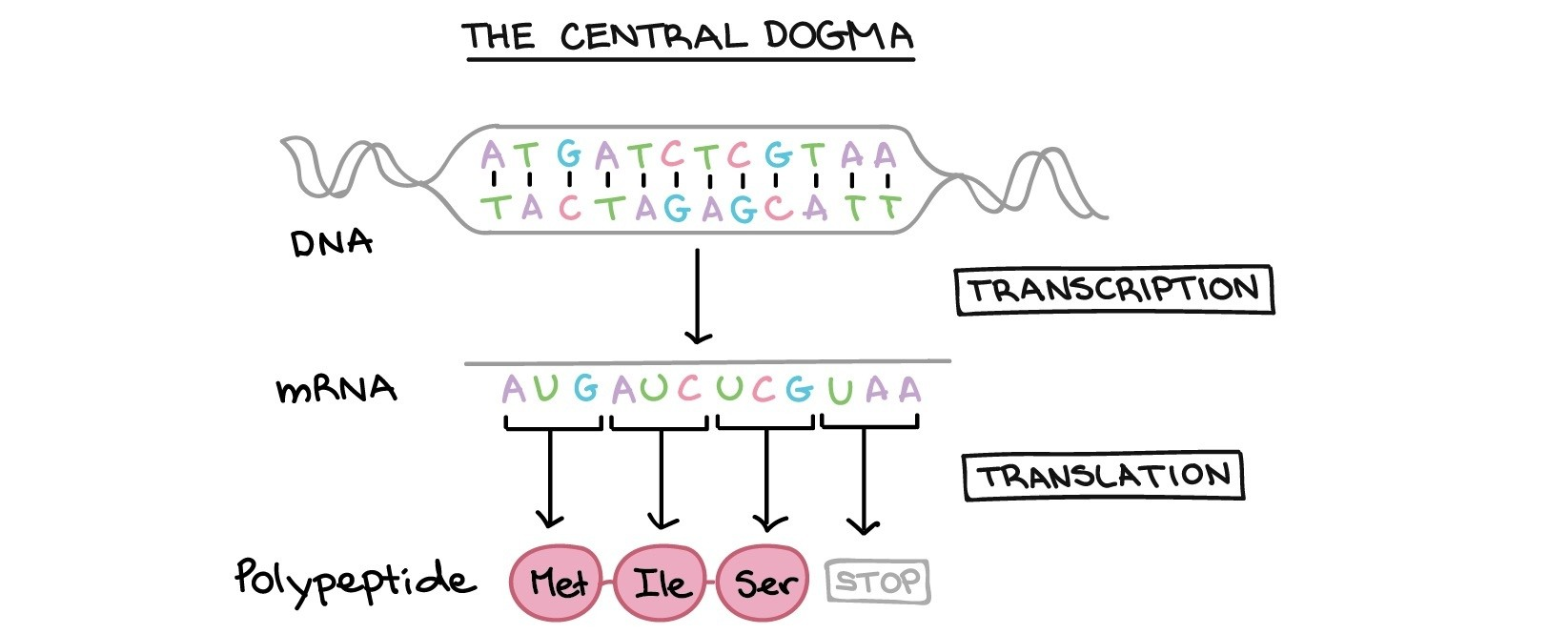
Topic Question 1: Define protein synthesis
Protein synthesis
Protein synthesis is a process.
The end product is a protein.
There are two main parts to the flow of information from gene to protein: transcription and translation.

Slide 21
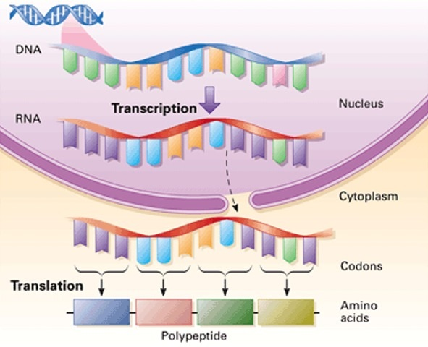
Protein synthesis
Topic Question 2: Define the two main stages involved in protein synthesis and state where these stages occur
Transcription
Is the synthesis of mRNA using the stored DNA code.
The synthesised mRNA is a chain of complementary RNA nucleotides, except that uracil (rather than thymine) is the base pair of adenine in RNA
Occurs in the nucleus

Slide 22
Topic Question 2: Define the two main stages involved in protein synthesis and state where these stages occur
Protein synthesis
Translation
is the synthesis of a polypeptide using the information in the mRNA.
The RNA nucleotide code is translated into an amino acid sequence at a ribosome in the cytoplasm.

Slide 23
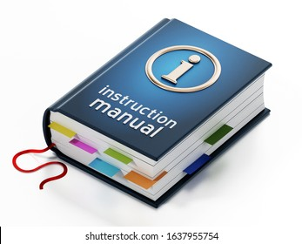
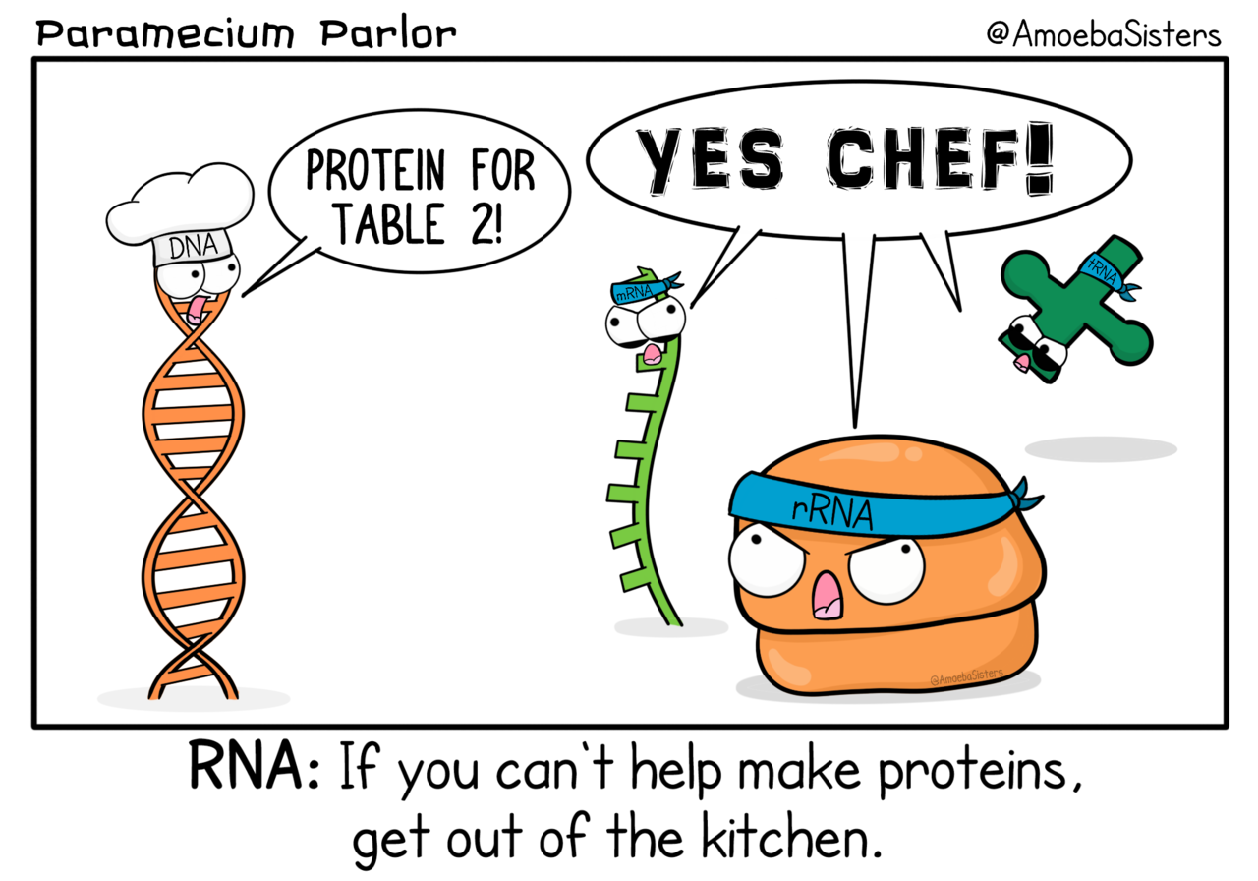
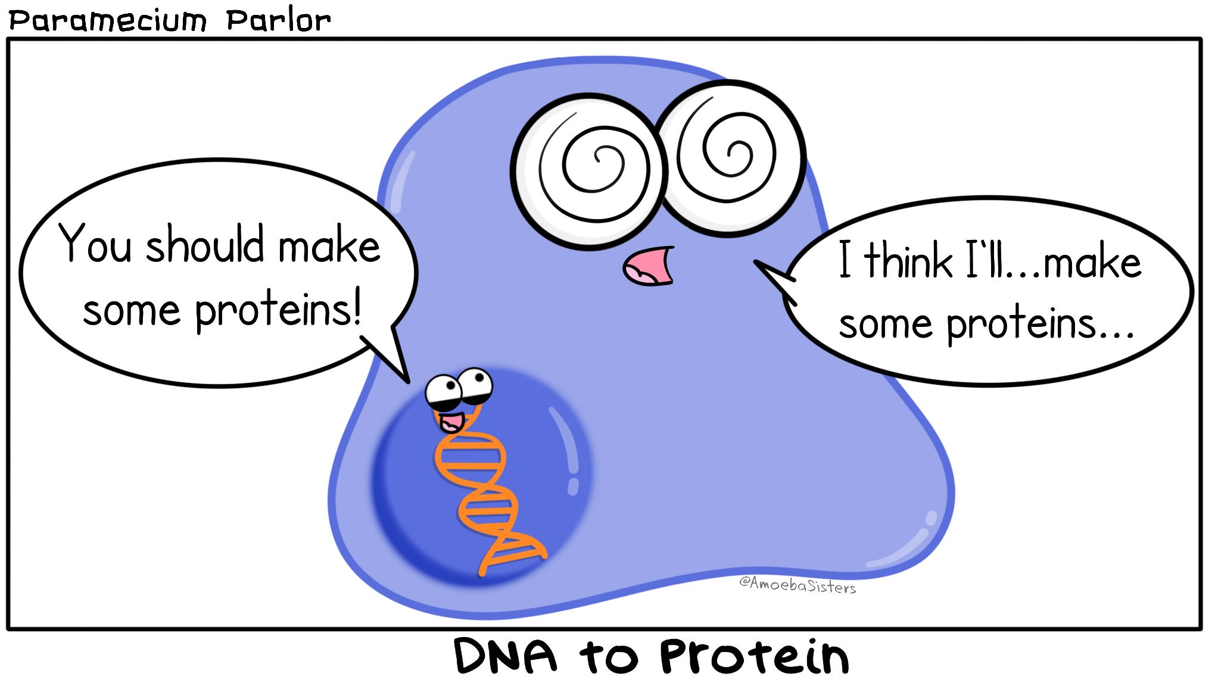
Topic Question 3: What are the essential materials required for protein synthesis?
Protein synthesis
Nucleic Acids
DNA stores the genetic code.

Slide 24
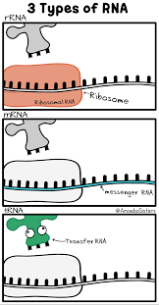
Topic Question 3: What are the essential materials required for protein synthesis?
Protein synthesis
Nucleic Acids
mRNA carries the copy of the DNA code which holds the coding sequence for protein synthesis and delivers this from the nucleus into the cytoplasm to the ribosome.
Interacts with tRNA and ribosome to ensure amino acids are assembled to form a protein

Slide 25
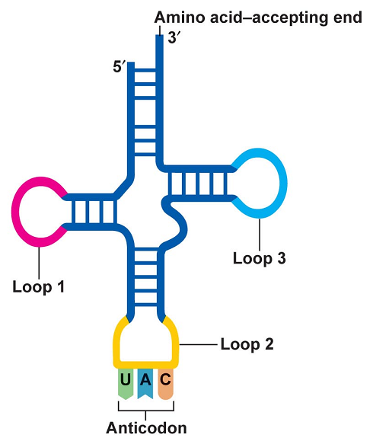
Topic Question 3: What are the essential materials required for protein synthesis?
Protein synthesis
Nucleic Acids
tRNA is found in the cytoplasm. It carries amino acids to the ribosome for protein synthesis specific to the mRNA codon. Has an anticodon complementary to the mRNA codon

Slide 26
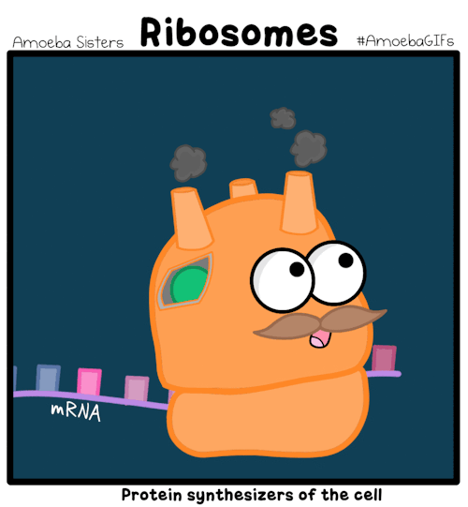
Topic Question 3: What are the essential materials required for protein synthesis?
Protein synthesis
Nucleic Acids
rRNA is a type of non-coding RNA which is the primary component of a ribosome. It direct the catalytic steps of protein synthesis — the stitching together of amino acids to make a protein molecule (https://www.nature.com/scitable/topicpage/ribosomes-transcription-and-translation-14120660/).

Slide 27
Topic Question 3: What are the essential materials required for protein synthesis?
Protein synthesis
Enzymes
Help break or form new bonds
RNA polymerase

Slide 28
Topic Question 3: What are the essential materials required for protein synthesis?
Protein synthesis
Codon
A series of three nucleotides found in mRNA called codons act as a code for an amino acid.
A START codon (AUG) initiates translation
a STOP codon (UAG) brings the process to an end.
Start codon

Slide 29
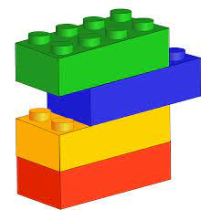
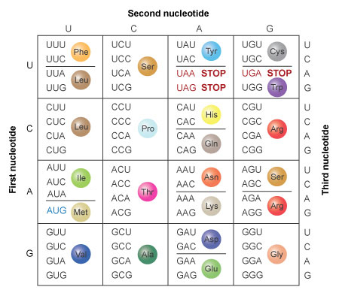
Topic Question 3: What are the essential materials required for protein synthesis?
Protein synthesis
Amino Acids
The building blocks of polypeptides and proteins.
There are twenty different amino acids
The sequence of amino acids is a type of code that specifies the structure and function of the protein, making it di­fferent from other proteins.
The mRNA codon specifies the ammino acid
Therefore the mRNA codon sequence determines the sequence of amino acids

Slide 30
Revision – Complementary Base Pair Rules for RNA
Protein synthesis
DNA nitrogenous base attached to the DNA nucleotide | RNA nitrogenous base attached to the RNA nucleotide that complements the DNA nucleotide
Adenine | Uracil
Thymine | Adenine
Cytosine | Guanine
Guanine | Cytosine

Slide 31
Protein synthesis − transcription
Topic Question 4: Describe what occurs during the first stage of protein synthesis
Watch: https://www.youtube.com/watch?v=LnZZqrcAPb4&list=PLsMs3sjjy-pCcR8l3ohnIUhIiCwEjQB6K&index=111&t=4s

Slide 32
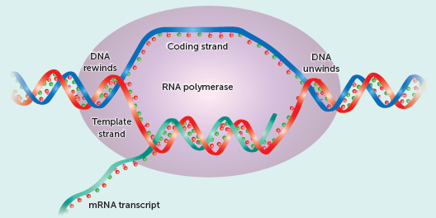
Protein synthesis − transcription
Topic Question 4: Describe what occurs during the first stage of protein synthesis
Step 1
In the nucleus
part of one gene becomes unzipped by the action of RNA polymerase, which breaks the weak hydrogen bonds joining the complementary nucleotides of DNA
Exposing the nucleotides of the template strand of DNA
Remember: a gene is a segment of DNA and codes for a specific protein

Slide 33
Protein synthesis − transcription
Topic Question 4: Describe what occurs during the first stage of protein synthesis
Step 2
The template strand (non-coding strand; antisense strand) is used for transcription and contains the information for the protein
RNA polymerase recognises the promoter region
RNA polymerase binds to a promoter region to initiate transcription

Slide 34
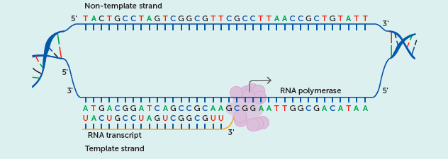
Protein synthesis − transcription
Topic Question 4: Describe what occurs during the first stage of protein synthesis
Step 3
RNA polymerase adds free-floating nucleotides according to the complementary base pair rules to synthesize a new molecule of single stranded mRNA
Cytosine is copied as guanine, guanine is copied as cytosine, thymine is copied as adenine and adenine is copied as uracil The new strand of mRNA is synthesised in a 5’ to 3’ direction.

Slide 35
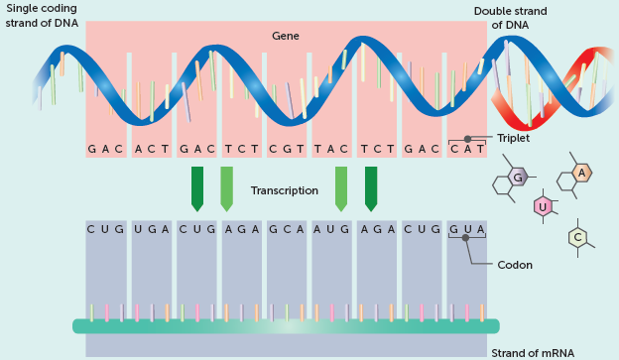
Protein synthesis − transcription
Topic Question 4: Describe what occurs during the first stage of protein synthesis
Step 4
The DNA bases are read in triplets
The complementary mRNA triplets are called codons.

Slide 36
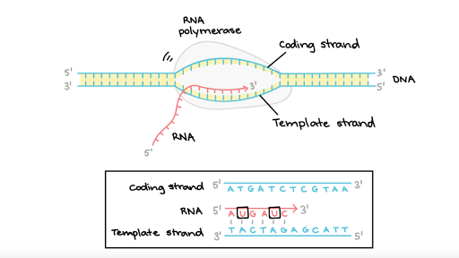
Protein synthesis − transcription
Topic Question 4: Describe what occurs during the first stage of protein synthesis
Step 4
The process continues until there is a termination site is reached and the pre-mRNA is released.
Termination site

Slide 37
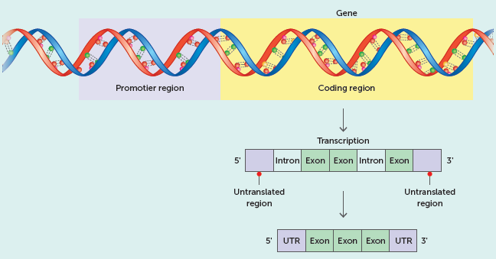
Protein synthesis − transcription
Topic Question 4: Describe what occurs during the first stage of protein synthesis
Step 5
Pre-mRNA consists of introns and exons.
Introns are removed and
exons are joined to create mature mRNA.

Slide 38
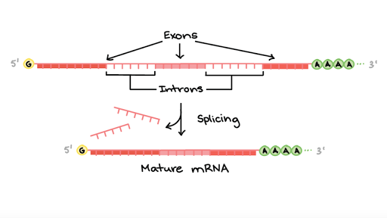
Protein synthesis − transcription
Topic Question 4: Describe what occurs during the first stage of protein synthesis
Step 5
A Poly A tail is added to the 3’ end
A Methylated cap is added to the 5’ end.
The Mature mRNA transcribed from DNA has a sequence complementary to the template DNA
Mature mRNA exits the nucleus via the nuclear pore.

Slide 39
Translation
Protein synthesis − translation
Topic Question 5: Describe what occurs during the second stage of protein synthesis
Initiation
A ribosome binds to a molecule of mRNA. A start codon signals the start of translation. Two codons enter and are bound to the ribosome. Following initiation, only one codon enters and is translated at a time.
Elongation
A tRNA molecule, which includes an anticodon, is attracted to the corresponding codon due to complementary base pairing. On the other side of the tRNA molecule is the amino acid specified by the codon. As one codon is read and exits, another one slides into the ribosome to be read. tRNAs transfer the amino acids to the mRNA–ribosomal complex in the order specified by the codons of the mRNA.
Termination
Elongation continues until a stop codon in the mRNA enters the ribosome.

Slide 40
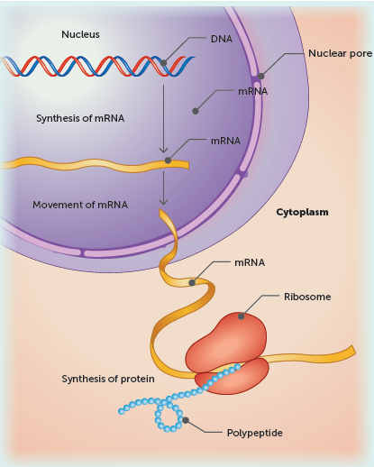
Protein synthesis − translation
Topic Question 5: Describe what occurs during the second stage of protein synthesis
Step 1 Initiation
mRNA attached to the ribosome
This occurs in the cytoplasm or on the ER

Slide 41
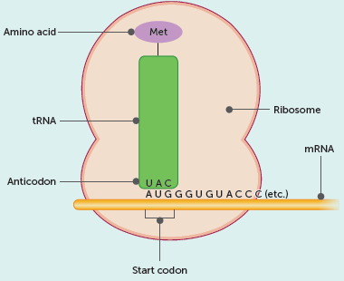
Protein synthesis − translation
Topic Question 5: Describe what occurs during the second stage of protein synthesis
Step 2 Elongation
The mRNA is read a codon at a time at the ribosome
Translation begins when the start codon of the mRNA is read, this is usually ‘AUG’.
tRNA then brings the first amino acid to the ribosome which is methionine
The particular amino acid that is brought to the ribosome by tRNA is specified by the mRNA codon which is complementary to the tRNA codon
5’
3’
Direction of translation

Slide 42
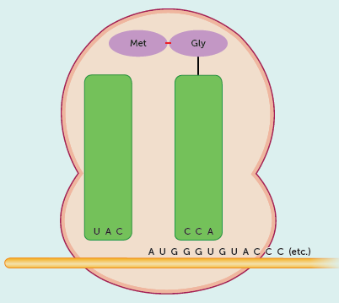
Protein synthesis − translation
Topic Question 5: Describe what occurs during the second stage of protein synthesis
Peptide bond
Step 3
tRNA continues to bring amino acids to the ribosome
The particular amino acid that is brought to the ribosome by tRNA is specified by the mRNA codon which is complementary to the tRNA codon
A peptide bond is formed between adjacent amino acids

Slide 43
Protein synthesis − translation
Topic Question 5: Describe what occurs during the second stage of protein synthesis
Step 3
Once tRNA has brought an amino acid to the ribosome and a peptide bond has formed between adjacent amino acids it leaves the ribosome to continue bringing more amino acids

Slide 44
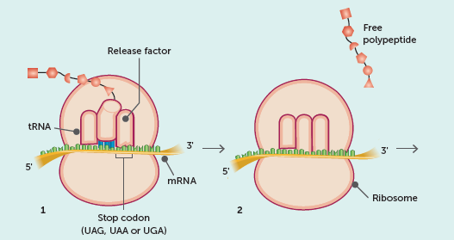
Protein synthesis − translation
Topic Question 5: Describe what occurs during the second stage of protein synthesis
Step 4 Termination
The polypeptide chain forms
Translation ends when a stop codon is reached
The polypeptide is released from the mRNA
The mRNA can be used again to make another protein

Slide 45
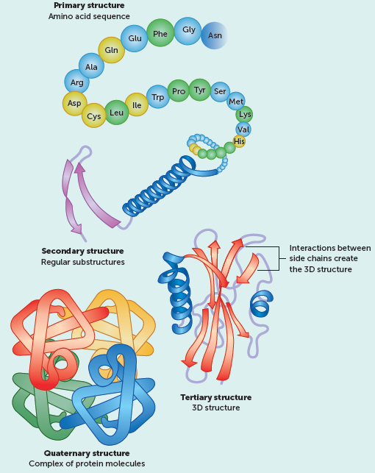
Protein synthesis − translation
Topic Question 5: Describe what occurs during the second stage of protein synthesis
Step 5
Translation is complete.

Slide 46
Topic Question 6: Label a diagram of protein synthesis

Slide 47
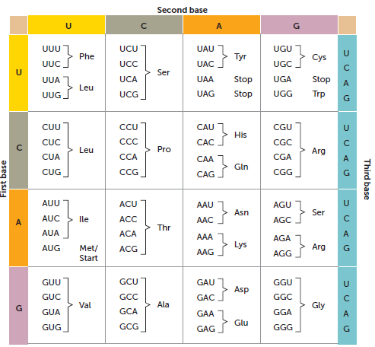
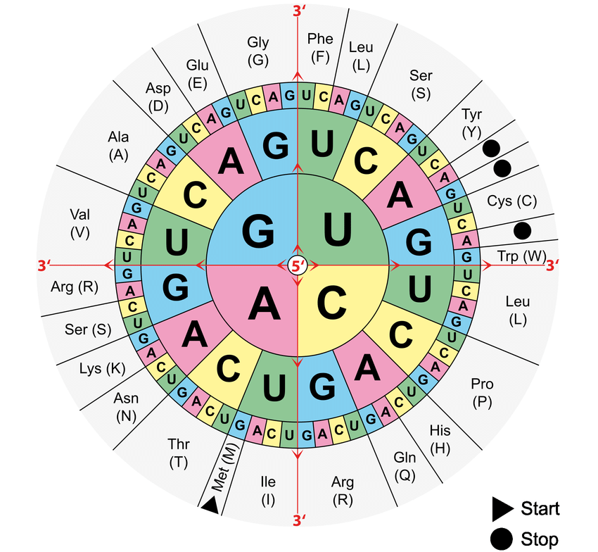
Proteins
Topic Question 7: How to use a codon table
An amino acid table (codon table) is a translation table.
To find the amino acid coded for by an mRNA codon, look for the three nitrogenous base letters in the table.
There are 64 possible base triplets and three of these are stop codons that signal for translation to stop.

